Slide 1
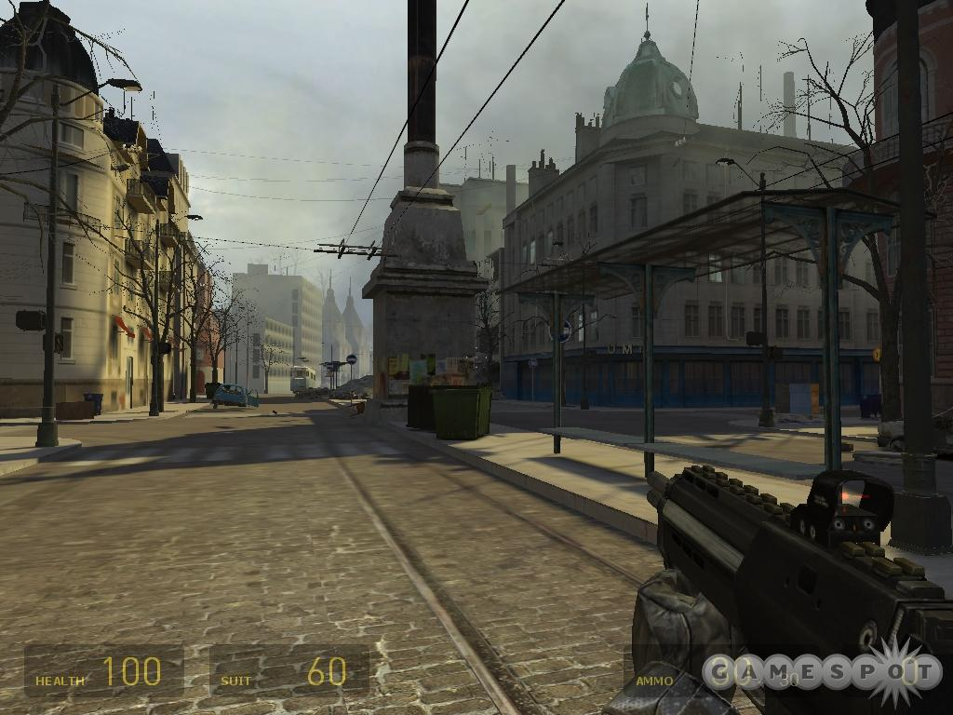
CSE 219
Computer Science III
Graphical User Interfaces
Half Life 2, by Valve, released 2004

Slide 2
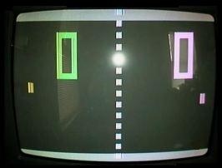
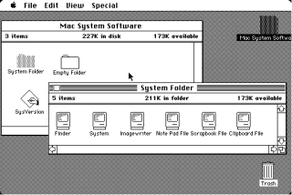
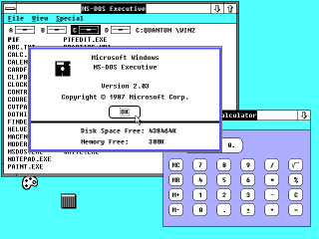
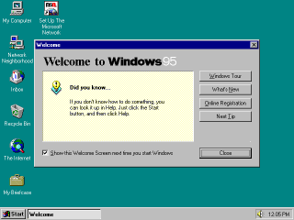
GUI Examples

Slide 3
GUI
Graphical User Interface (GUI)
  provides user-friendly human interaction
Building Java GUIs require use of multiple frameworks:
  Java’s GUI component Libraries
    javax.swing.*
  Java’s Event Programming Libraries
    java.awt.event.*
    Javax.swing.event.*
  Java’s Graphics Programming Libraries
    java.awt.*
    java.awt.geom.*

Slide 4
How do GUIs work?
A giant loop
Construct GUI Components
Render GUI
Check to see if any input
Respond to user input

Slide 5
Example, a mouse click on a button
Operating System recognizes mouse click
  determines which window it was inside
  notifies that program
Program runs in loop
  checks input buffer filled by OS
  if it finds a mouse click:
    determines which component in the program
    if the click was on a relevant component
      respond appropriately according to handler

Slide 6
GUI Look vs. Behavior
Look
  physical appearance
  custom component design
  containment
  layout management
Behavior
  interactivity
  event programmed response

Slide 7
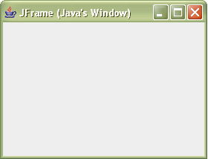
What does a GUI framework do for you?
Provides ready made visible, interactive, customizable components
  you wouldn’t want to have to code your own window

Slide 8
The JFrame
Java’s top-level window
  a window that is not contained inside another window
Has methods for:
  used to specify window to fit screen
    setExtendedState
  specifying a response to clicking window’s ‘X’
    setDefaultCloseOperation
  specifying size and location (top-left corner)
    setSize, setLocation (inherited from Component)
Many other useful methods inherited from ancestors

Slide 9
javax.swing.JFrame Class Hierarchy
Object
Component
Container
Window
Frame
JFrame

Slide 10
Useful Inherited Methods for JFrames
Frame
  setting window’s icon
    setIconImage(Image image)
    images can be loaded via:
      Toolkit.getDefaultToolkit.getImage(String fileName)
Window
  for hiding window
    hide()
  for tightly packing all components inside frame
    pack()
Component
  for displaying window
    setVisible(boolean b)

Slide 11
Defining your own JFrame class
import java.awt.Image;
import java.awt.Toolkit;
import javax.swing.JFrame;
public class MyEmptyFrame extends JFrame {
public MyEmptyFrame() {
super("MyEmptyFrame");
setDefaultCloseOperation(JFrame.EXIT_ON_CLOSE);
Toolkit tk = Toolkit.getDefaultToolkit();
Image frameIcon = tk.getImage("NYYankees.jpg");
setIconImage(frameIcon);
setExtendedState(MAXIMIZED_BOTH);
}
}
Sets frame title
Terminates program when frame closed
Sets frame icon
Maximizes frame

Slide 12
Displaying our MyEmptyFrame
Construct a MyEmptyFrame object
Call setVisible(true) to make the frame visible, this spawns a thread which:
  opens the window
  starts an event handling loop for the window
    the program is then event-driven
What’s a thread?
  allows different code to run in parallel
  more on this in coming lectures

Slide 13
An Executable MyEmptyFrame
import java.awt.*;
import javax.swing.JFrame;
public class MyEmptyFrame extends JFrame {
public MyEmptyFrame() {
super("MyEmptyFrame");
setDefaultCloseOperation(JFrame.EXIT_ON_CLOSE);
Toolkit tk = Toolkit.getDefaultToolkit();
Image frameIcon = tk.getImage("NYYankees.jpg");
setIconImage(frameIcon);
setExtendedState(MAXIMIZED_BOTH);
}
public static void main(String[] args) {
MyEmptyFrame frame = new MyEmptyFrame();
frame.setVisible(true);
}
}

Slide 14
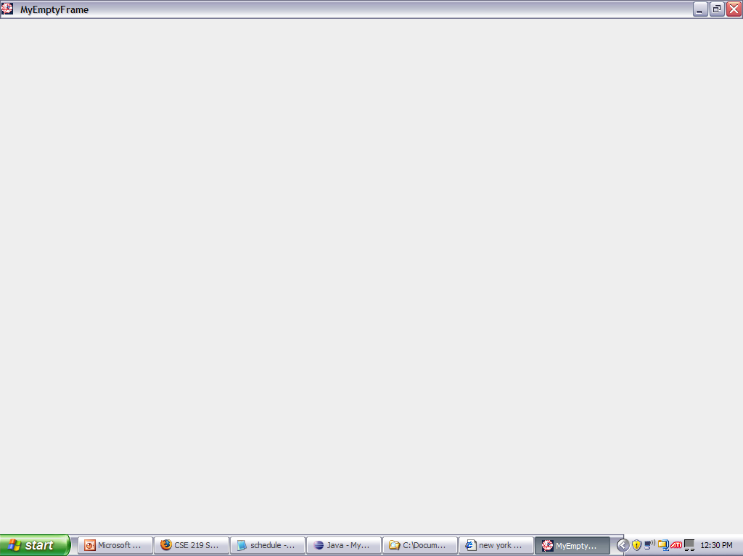
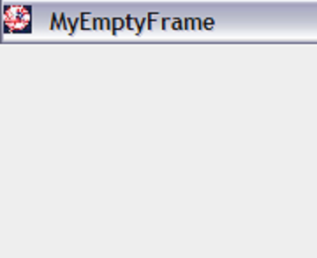

Slide 15
Containment
A Container object is used to hold GUI components. Like what?
  buttons, text fields, text areas, etc.
All Swing components (ex: JPanel) are descendants of the Container class
Components are added to a Container using the add method
  when a Component is added to a Container it will appear inside that Container

Slide 16
JPanels
JPanels are blank components
They are useful for two purposes:
  Drawing on them
  Laying out other GUI components
  JPanels are used to neatly organize your GUI components (ex: buttons) into separate groupings
Either draw on a panel or place components inside it, never both simultaneously

Slide 17
javax.swing.JPanel Class Hierarchy
Object
Component
Container
JComponent
Window
JPanel
Frame
JFrame

Slide 18
Simple GUI Programming TIP
To start creating a GUI using Swing:
Define your own class that extends JFrame
Make all of your necessary GUI components instance variables
  buttons, text areas, etc.
When your class is constructed, setup the GUI
  construct all necessary components
  layout all components inside your frame
  specify all event handlers (next lecture)

Slide 19
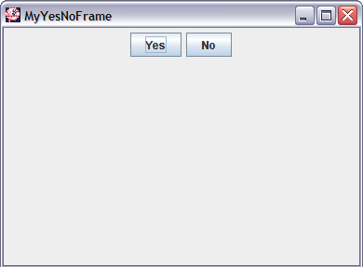
Using a JPanel to organize buttons
public class MyYesNoFrame extends JFrame
{
private JPanel panel = new JPanel();
private JButton yesButton = new JButton("Yes");
private JButton noButton = new JButton("No");
…
public MyYesNoFrame()
{
…
panel.add(yesButton);
panel.add(noButton);
this.add(panel);
}

Slide 20
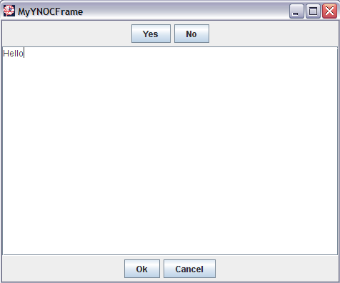
How many GUI components do you see?
JButton
JButton
JPanel
JTextArea
(usually contained inside a JScrollPane)
JPanel
JButton
JButton

Slide 21
Containment hierarchy
MyYNOCFrame frame
  JPanel northPanel
    JButton yesButton
    JButton noButton
  JScrollPane jsp
    JTextArea textArea
  JPanel southPanel
    JButton okButton
    JButton cancelButton

Slide 22
MyYNOCFrame’s components
import java.awt.*;
import javax.swing.*;
public class MyYNOCFrame extends JFrame {
private JPanel northPanel = new JPanel();
private JButton yesButton = new JButton("Yes");
private JButton noButton = new JButton("No");
private JTextArea myTextArea = new JTextArea();
private JScrollPane jsp = new JScrollPane(myTextArea);
private JPanel southPanel = new JPanel();
private JButton okButton = new JButton("Ok");
private JButton cancelButton = new JButton("Cancel");
public MyYNOCFrame() {
super("MYYNOCFrame");
setDefaultCloseOperation(JFrame.EXIT_ON_CLOSE);
Toolkit tk = Toolkit.getDefaultToolkit();
Image frameIcon = tk.getImage("NYYankees.jpg");
setIconImage(frameIcon);
setExtendedState(MAXIMIZED_BOTH);
layoutGUI();
}

Slide 23
Laying out MyYNOCFrame
public void layoutGUI() {
northPanel.add(yesButton);
northPanel.add(noButton);
southPanel.add(okButton);
southPanel.add(cancelButton);
this.add(northPanel, BorderLayout.NORTH);
this.add(jsp, BorderLayout.CENTER);
this.add(southPanel, BorderLayout.SOUTH);
}
…
Uses a layout manager to position components inside a container

Slide 24
Layout Managers
Java layout managers use algorithms to position and size GUI components inside a container
  every container has its own layout manager
  the layout manager decides how to arrange contents when:
    a container is made visible
    a container is resized or moved

Slide 25
LayoutManager
An interface in java.awt package
  classes that implement LayoutManager define algorithms for placing displaying components inside containers.
Some classes that implement LayoutManager:
  FlowLayout, BorderLayout, BoxLayout, GridLayout, GridBagLayout
    Note: for these, setPreferredSize does nothing
  What about null?
    setPreferredSize specifies exact component dimensions

Slide 26
Layout Management
Appearance is determined by:
  type of layout manager
  order components are added to container
  location parameters used for adding components
To specify a layout for a Container
  use setLayout method
  or, use the default layout manager
Default Layout Mangers:
  JPanel: FlowLayout
  JFrame: BorderLayout

Slide 27
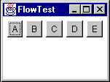
FlowLayout
Simplest, placed components:
  left to right
  in order of calls to add
  components aligned LEFT, RIGHT, or CENTER
  starts a new row if needed
JFrame frame = new Frame(“FlowTest”);
JPanel panel = new JPanel();
panel.add(new JButton("A"));
panel.add(new JButton("B"));
panel.add(new JButton("C"));
panel.add(new JButton("D"));
panel.add(new JButton("E"));
frame.add(panel);

Slide 28
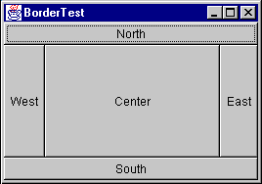
BorderLayout
5 regions (CENTER, NORTH, SOUTH, EAST, WEST)
  1 component allowed in each
    that component may also contain other components
North/south stretched horizontally
East/west stretched vertically
JFrame frame = new JFrame("BorderTest");
frame.add(new JButton("North"), BorderLayout.NORTH);
frame.add(new JButton("South"), BorderLayout.SOUTH);
frame.add(new JButton("East"), BorderLayout.EAST);
frame.add(new JButton("West"), BorderLayout.WEST);
frame.add(new JButton("Center"), BorderLayout.CENTER);

Slide 29
Which LayoutManager to use?
My advice: keep it simple
Use:
  BorderLayout to organize panels inside of a JFrame or another JPanel
  FlowLayout to organize components inside panels
    ex: Jbuttons
  we’ll use GridBagLayout in HWs for dialogs
  sometimes it is useful to place other JPanels containing components inside JPanels
Using these simple layouts, you can design the layout of many applications (including our project)

Slide 30
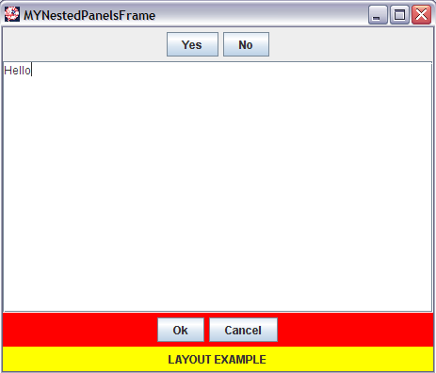
JPanels inside other JPanels
JPanel
JPanel
JPanel

Slide 31
MyNestedPanelsFrame’s components
import java.awt.*;
import javax.swing.*;
public class MyNestedPanelsFrame extends JFrame {
…
private JPanel southPanel = new JPanel();
private JPanel northPanelInSouthPanel = new JPanel();
private JPanel southPanelInSouthPanel = new JPanel();
private JButton okButton = new JButton("Ok");
private JButton cancelButton = new JButton("Cancel");
private JLabel statusLabel = new JLabel("LAYOUT EXAMPLE");
public MyNestedPanelsFrame() {
…
layoutGUI();
}

Slide 32
Laying out MyNestedPanelsFrame
public void layoutGUI() {
northPanel.add(yesButton);
northPanel.add(noButton);
southPanel.setLayout(new BorderLayout());
northPanelInSouthPanel.add(okButton);
northPanelInSouthPanel.add(cancelButton);
northPanelInSouthPanel.setBackground(Color.RED);
southPanelInSouthPanel.add(statusLabel);
southPanelInSouthPanel.setBackground(Color.YELLOW);
southPanel.add(northPanelInSouthPanel, "North");
southPanel.add(southPanelInSouthPanel, "South");
add(northPanel, BorderLayout.NORTH);
add(jsp, BorderLayout.CENTER);
add(southPanel, BorderLayout.SOUTH);
}

Slide 33
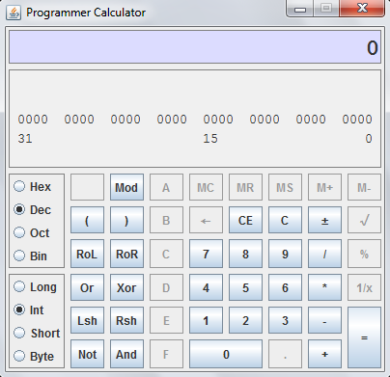
And more complicated layouts?
We can use GridBagLayout

Slide 34
GridBagLayout
Components are placed at column, row locations
Has lots of custom options
  Select options via GridBagConstraints objects
Components may:
  span multiple columns or rows
  fill entire cells (or not)
  have preferred sizes (width/height) set
To use, plan your grid

Slide 35
How many rows and columns?

